Slide 1

A Short Intro to FIJI

Slide 2
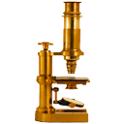

What are ImageJ and FIJI?
ImageJ is a Java-based, graphic user interface-based, image analysis package
FIJI (“FIJI is just ImageJ”) is a widely-use distribution of ImageJ that comes pre-packaged with a useful set of additional plugins.
Free, open-source software.
Popular platforms, both for users, and developers who create new plugins for specific purposes.

Slide 3
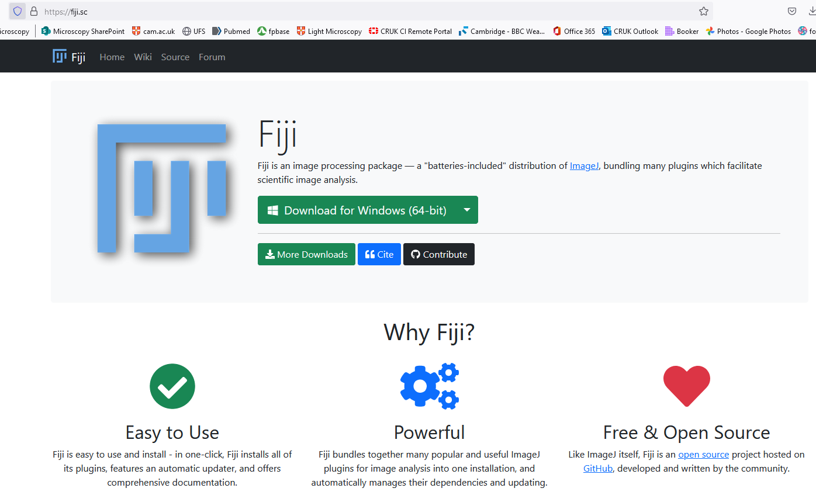
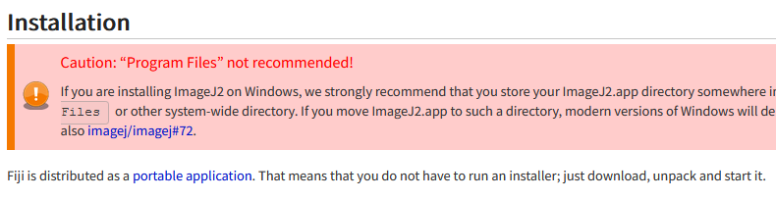
Installation and startup
A portable application (you can keep it on a remote disk, or even thumbdrive)
Usually not recommended to save it in your C:\Program Files\ for permissions reasons
https://fiji.sc
https://imagej.net/software/fiji/downloads

Slide 4

Background: What is an image?
The Golden Rule of image analysis:
Your pixel values ARE your data.
Guard them with your life.
An array of pixel values – ‘intensities’ of some measurement.
In our case, usually the photons arriving at the camera/detector; ‘brightness’

Slide 5
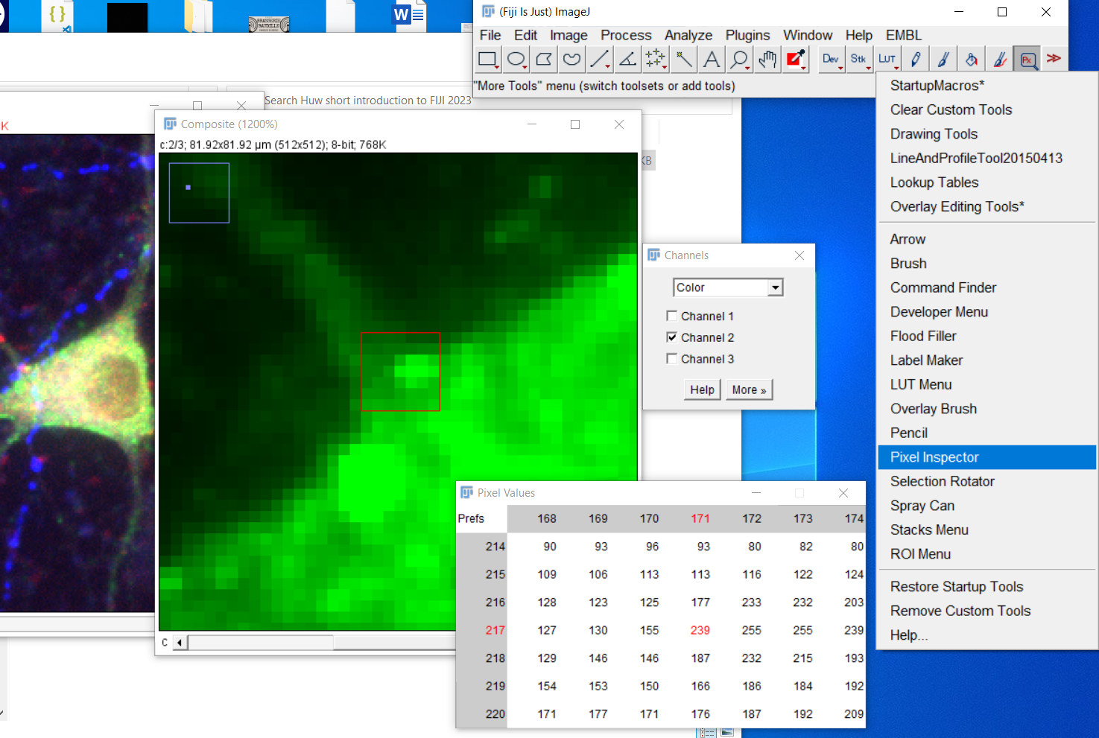
Background: Thinking in pixel values in FIJI

Slide 6
Background: Types of images and bitdepth
An RGB image takes 24bits per pixel (8-bit for each of the 3 colours)
2⁸ = 256, so values 0-255
2¹⁶ = 65536, so values 0-65535

Slide 7
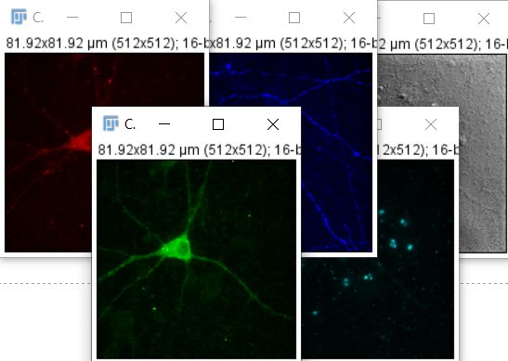
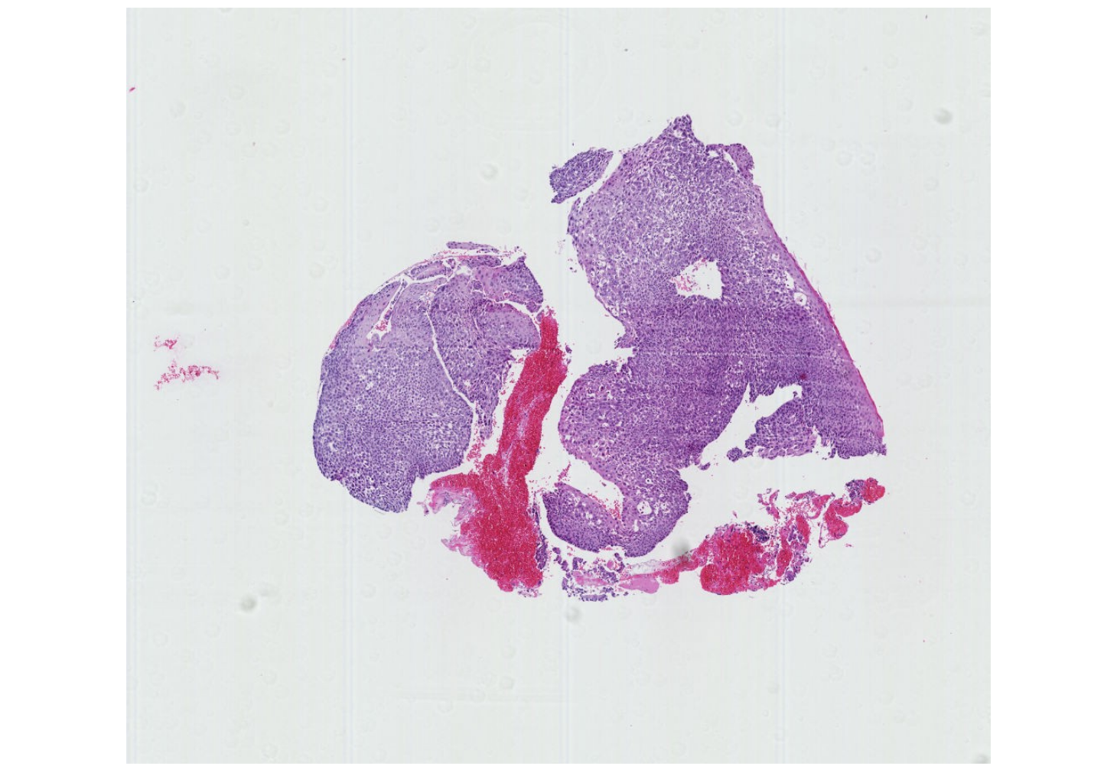
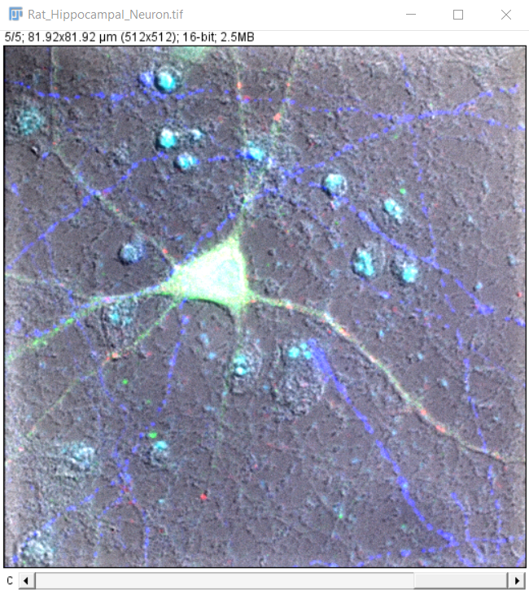
Typical examples:
Pennycuick A et al 2020
https://doi.org/10.1158/2159-8290.CD-19-1366
IDR 9846228
Pathology slide image:
Chromogenic staining
Colour camera -> RGB images
Microscopic IF image:
Fluorescence staining
Monochrome camera -> 16-bit or 8-bit images, one per channel

Slide 8
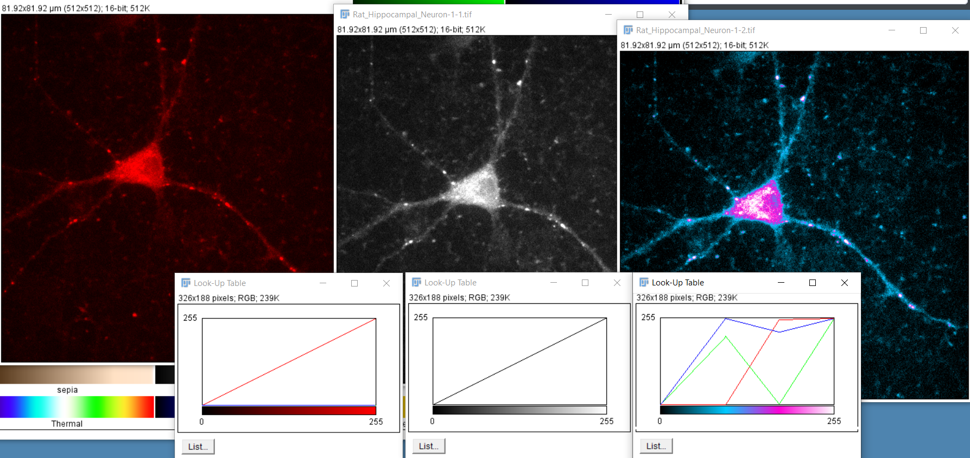
Background: Lookup tables (LUTs)

Slide 9
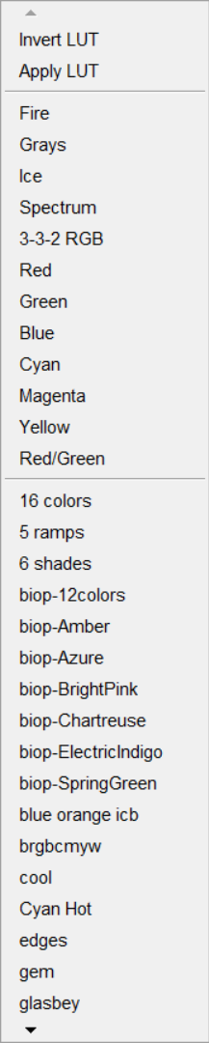
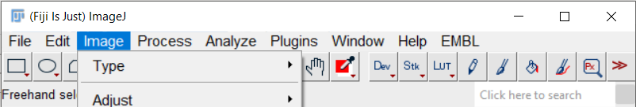
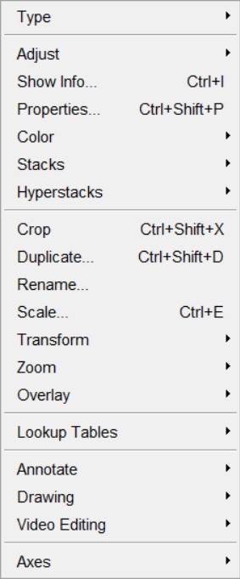
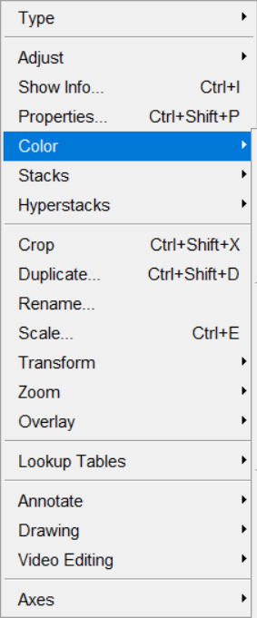
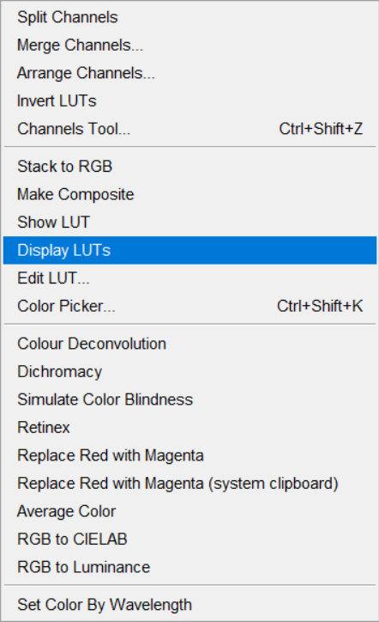
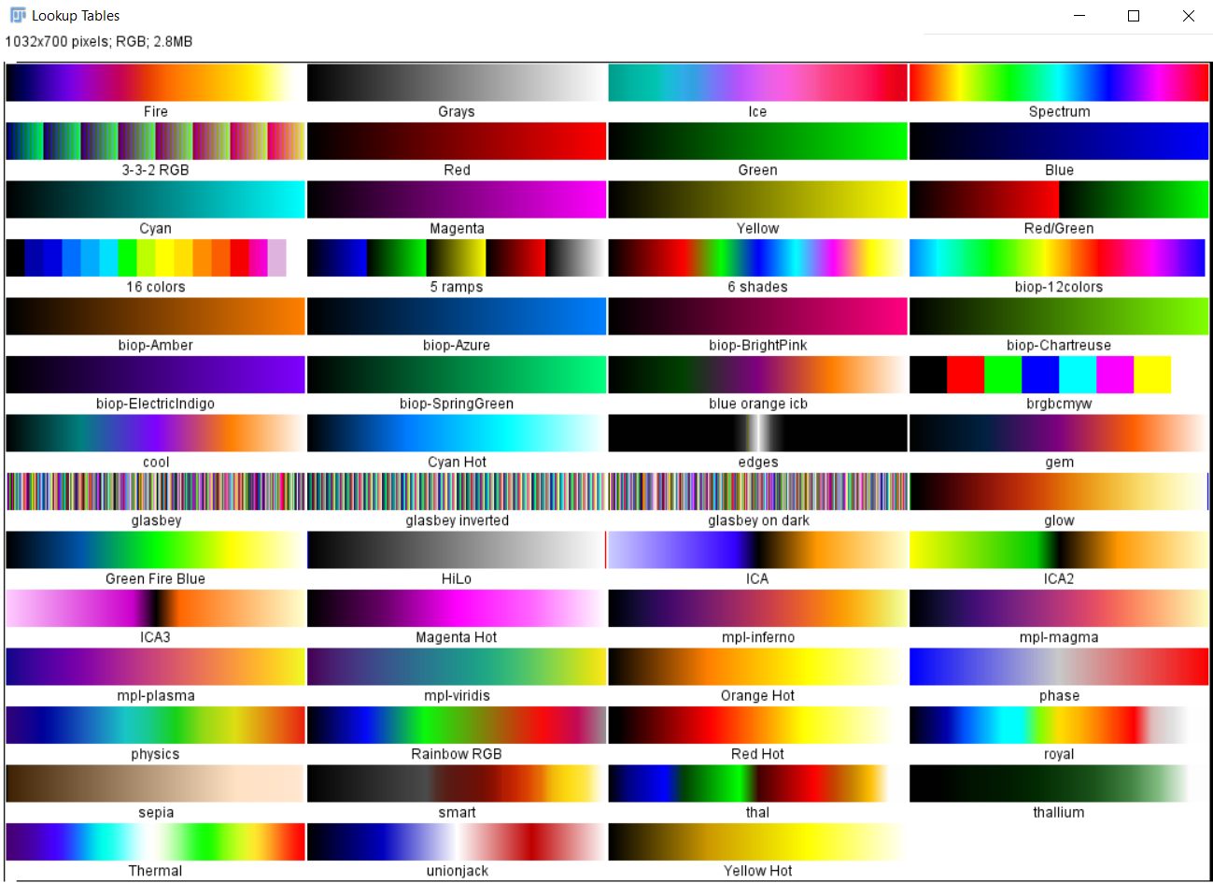
Background: Lookup tables (LUTs)
Assign LUT to current image

Slide 10
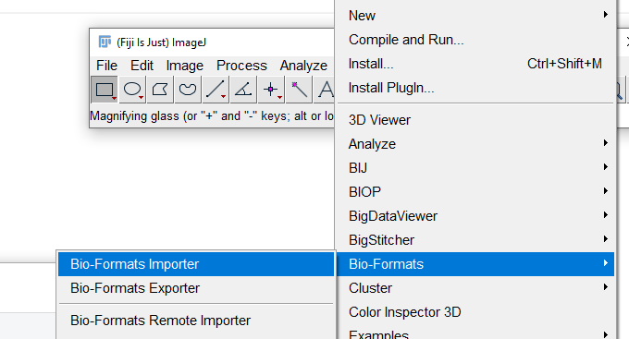
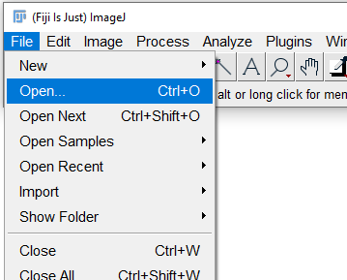
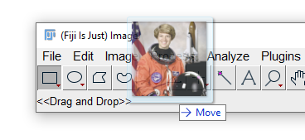
Opening an image
From the File menu…
… or from Plugins >
Bio-Formats >
Bio-Formats Importer
… by drag-and-drop …

Slide 11


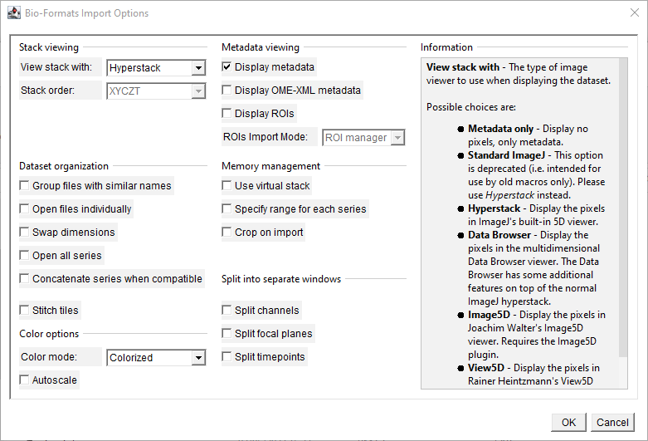
Opening an image
Bio-Formats is an open-source library that can be used to open many different image file formats, and serve up the images to software like FIJI.
Files such as .czi (Zeiss microscopes) and .lif (Leica), which are proprietary formats, are then accessible to us in FIJI.
https://www.openmicroscopy.org/bio-formats/
The Bio-Formats import dialog can be intimidating at first sight, but it does (try to) help you.
Take your time to think about the options you want, and ask for help if you need it!

Slide 12
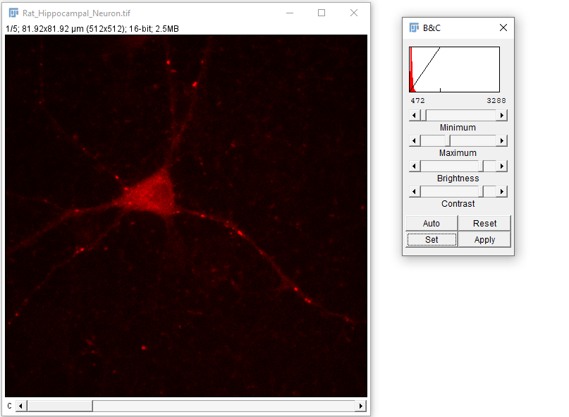
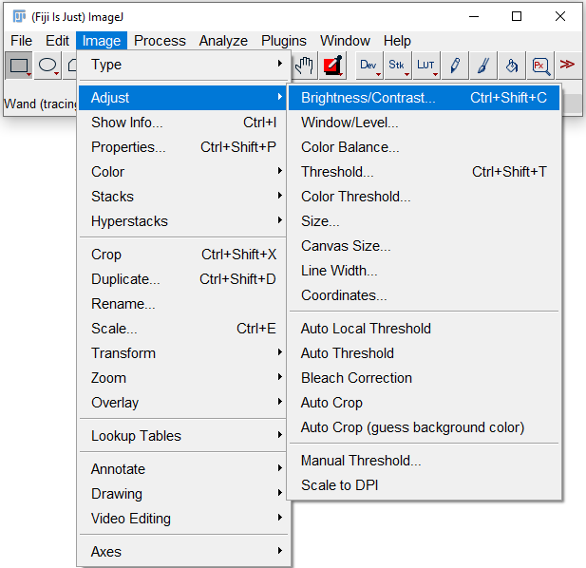
Adjusting the image display

Slide 13
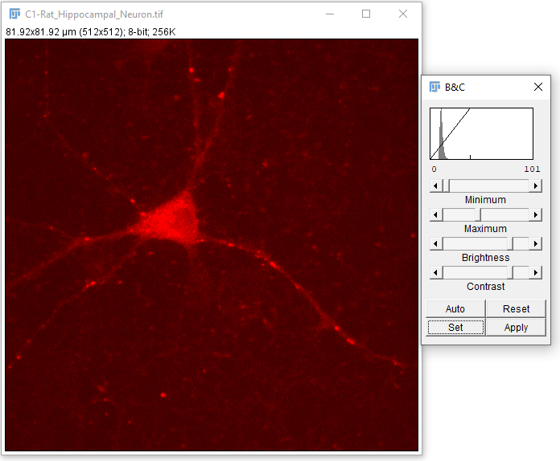
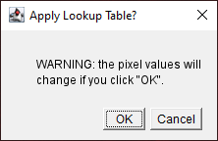
Things that will screw up your pixel values #1:
If you do click this, FIJI will explicitly warn you about what’s about to happen.
Your pixel values will be adjusted to fit the scale that you currently have visible.
!

Slide 14
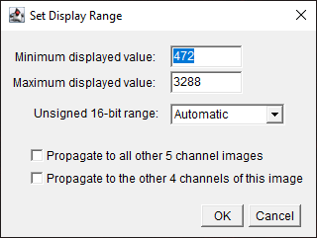
Adjusting the image display

Slide 15
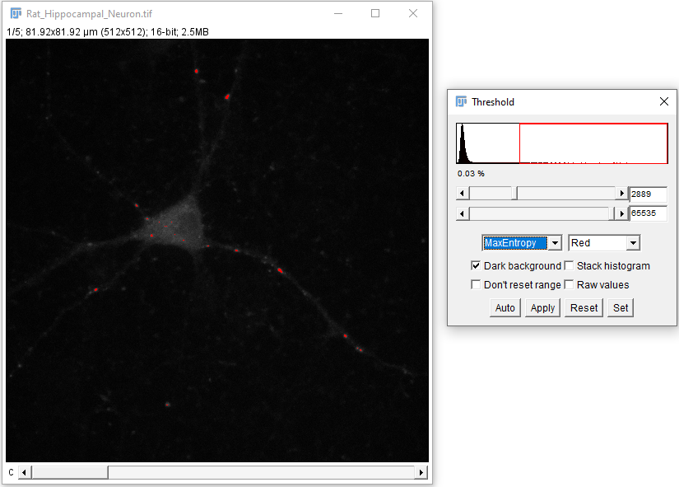
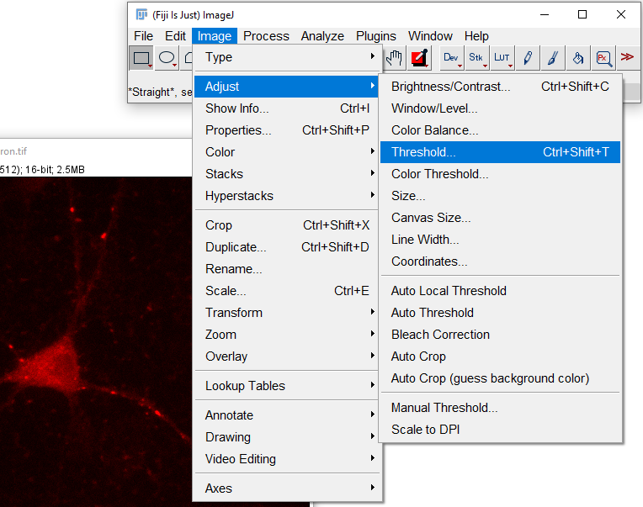
Thresholding

Slide 16
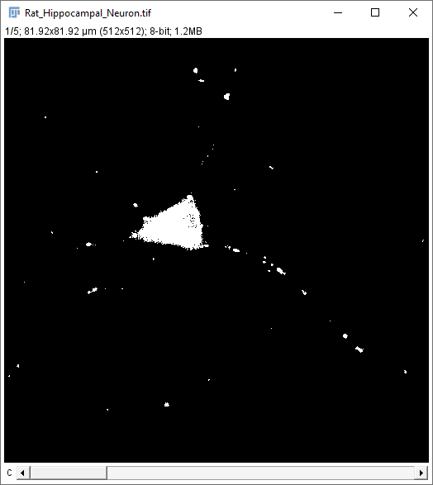
Thresholding
Clicking ‘Apply’ converts the image to a binary image – pixels that were below the threshold become 0, those above it become 255 (max on 8-bit scale).

Slide 17
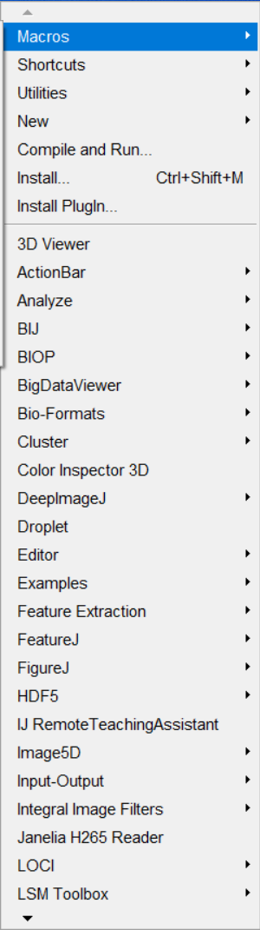
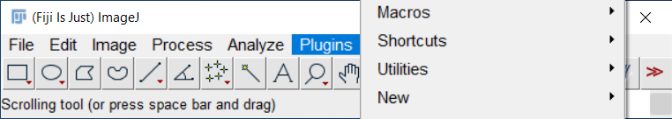
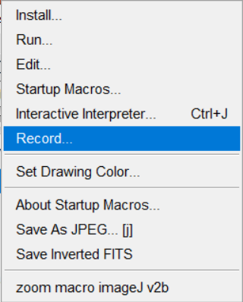
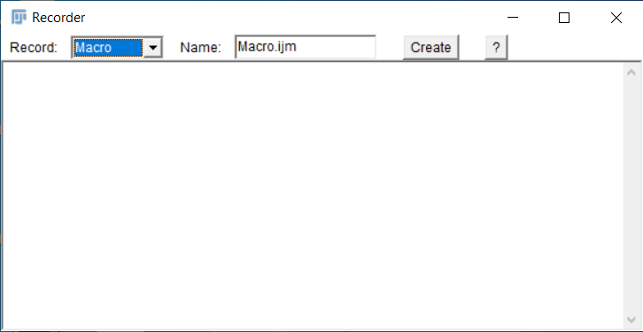
Scripting in FIJI and the Macro Recorder
A premature intro – let’s leave this running in the background and come back to it later.
You’ll see code for the things we click on appear in the recorder window.

Slide 18
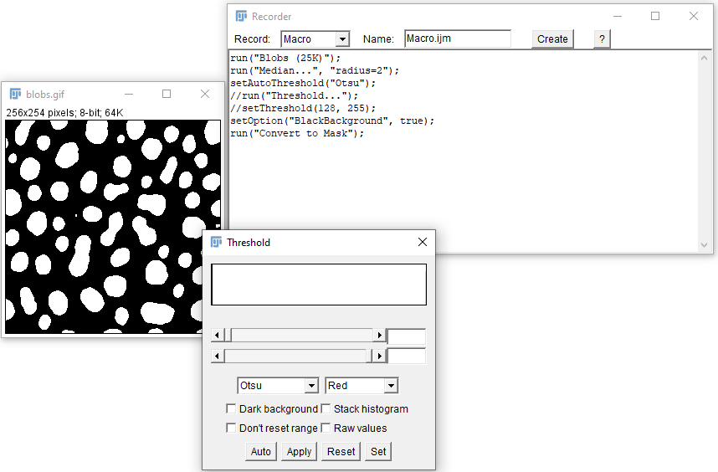
Macro Recorder
This is the raw recording of a simple procedure.
Depending on what you clicked, it may need some modifications to create a useable script.

Slide 19
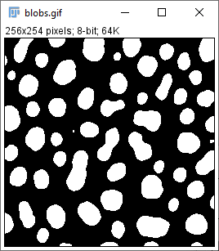
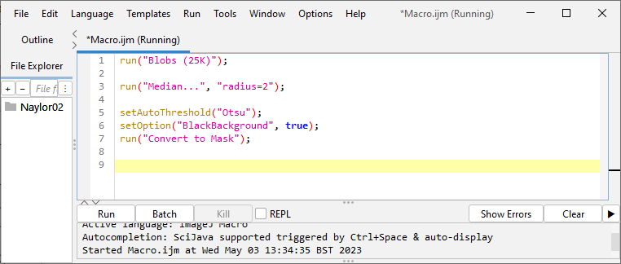
Macro Recorder
A sequence of operations is now reduced to a single click.
We’ll work up this further later on.

Slide 20
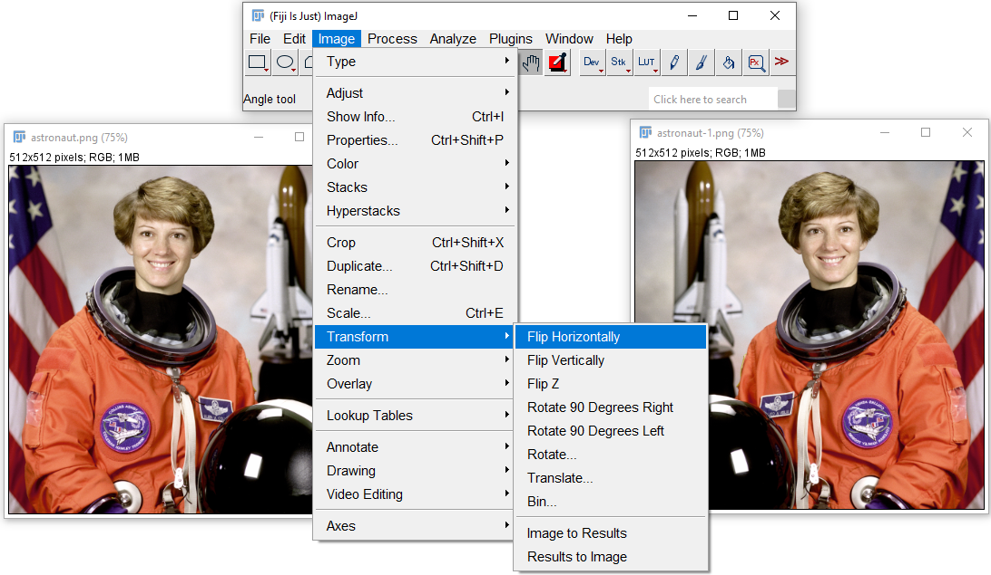
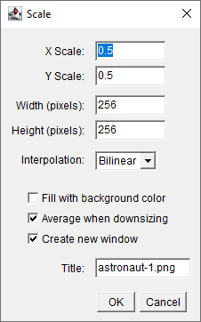
Transformations (flip, scale, etc.)

Slide 21
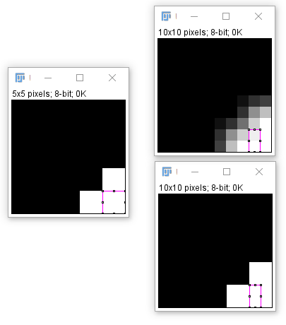
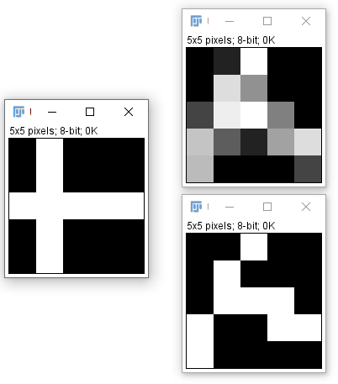
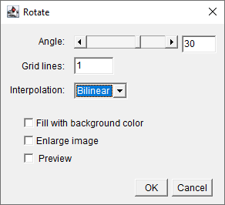
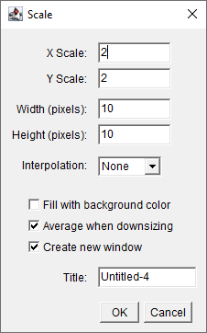
Things that will screw up your pixel values #2:
30° rotation, with and without interpolation
2x scale-up, with interpolation
no interpolation
Perhaps obvious, but scaling images up or down, and rotating them (except by a multiple of 90°) will cause some changes to pixel values. Pay attention to what effect any interpolation has.

Slide 22
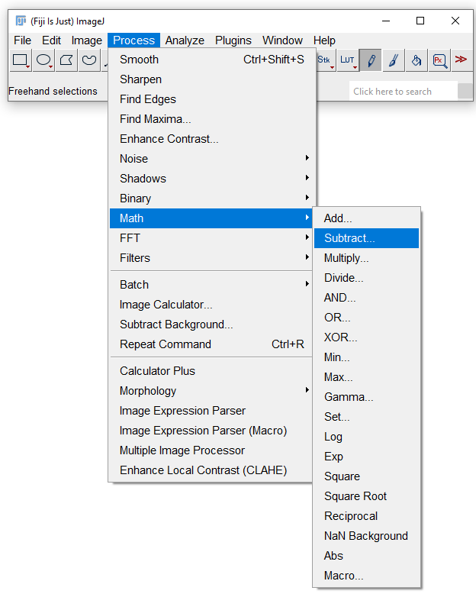
Process > Math

Slide 23
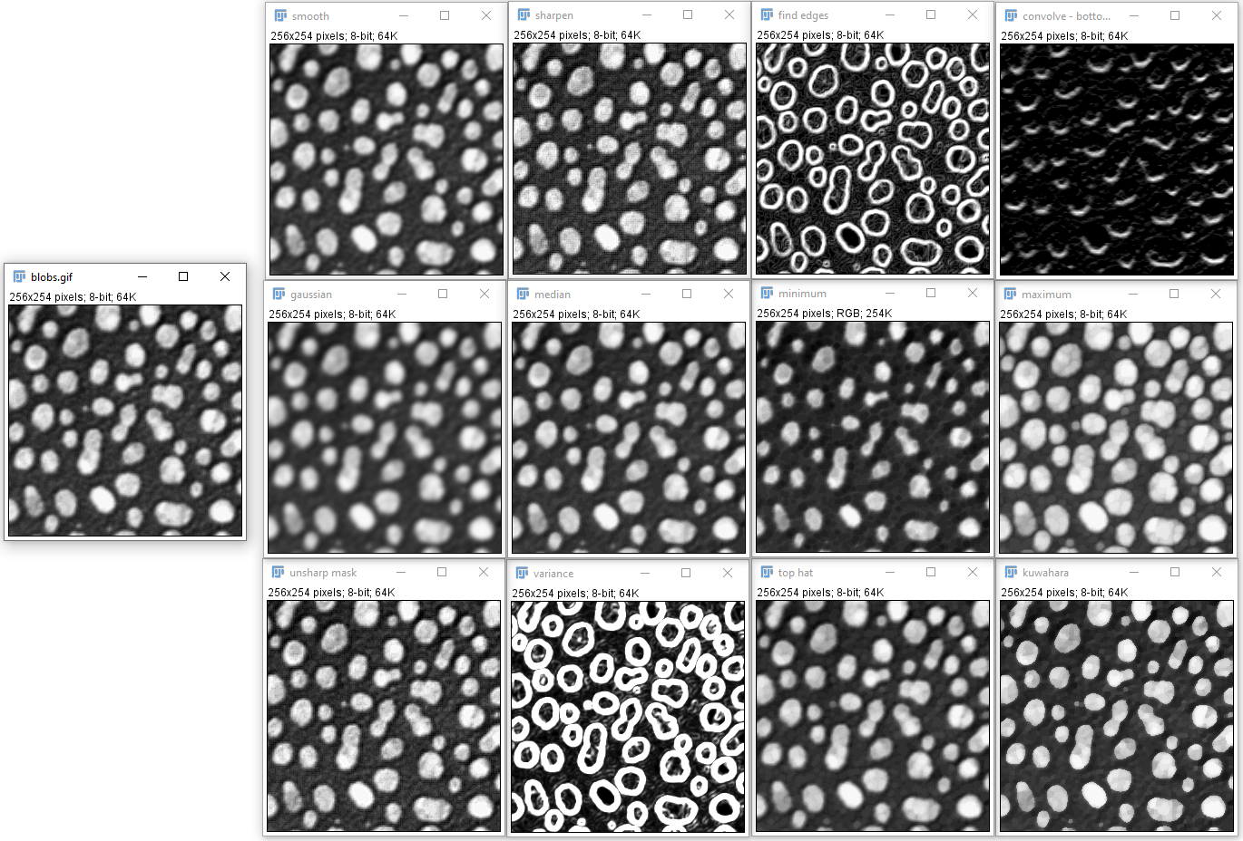
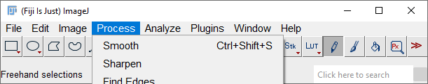
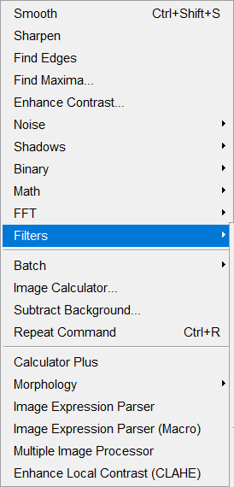
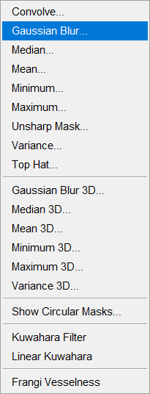
Process > Filters
Kernel: 1 1 1
0 0 0
-1 -1 -1

Slide 24
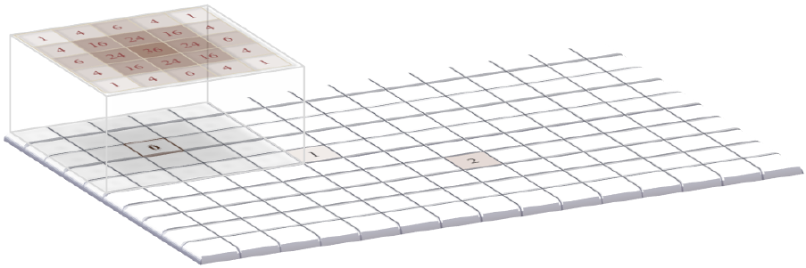
Filtering

Slide 25
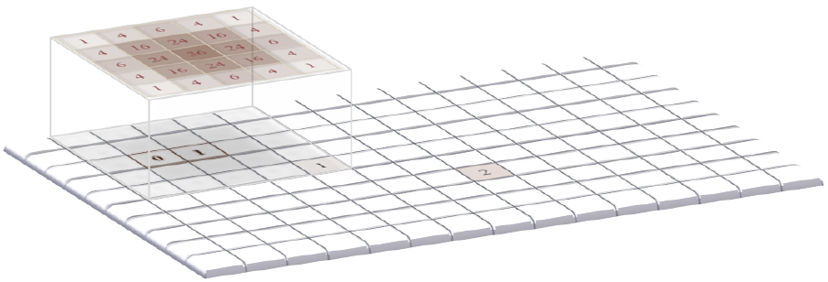
Filtering

Slide 26
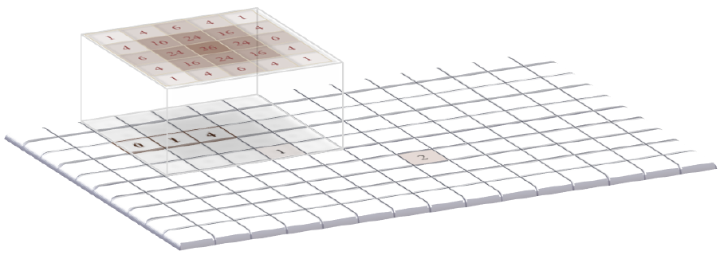
Filtering

Slide 27
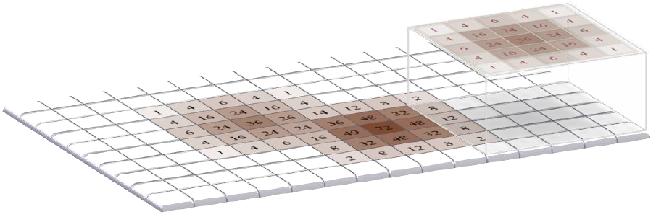
Filtering

Slide 28
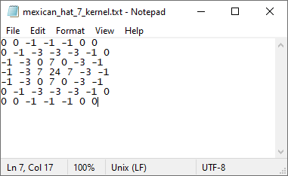
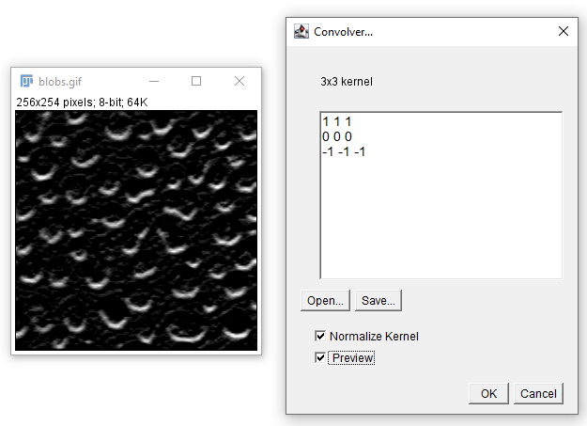

Filtering

Slide 29
More dimensions: stacks; timelapses, etc.

Slide 30




More dimensions: stacks; timelapses, etc.

Slide 31

File formats: tif, jpg, proprietary formats…
Tiff is often the de facto standard for scientific images – a long-standing, highly flexible format that can accommodate many types of image (dimensions etc).
Jpg and png are more often used for consumer photos and small online images, where file size is a greater concern. But the compression of the image does not preserve data.
Original tif
Compressed jpg – looks OK ???

Slide 32

Things that will screw up your pixel values #3:
Conversion to jpg, png etc is a LOSSY compression – your file size will be much smaller, but there’s a cost: this ‘blockiness’ around object edges is an artefact of the compression algorithm.
Often not obvious, and wouldn’t always cause a problem, but take care: any image analysis method that assumed a natural pixel distribution may run into problems.

Slide 33




Selections
Hint: right-click on these buttons for alternative tool; double-click them for options.

Slide 34


Selections
(the whole image)
Remove selection
Bring back a selection – including from a *different image*
Many tools for manipulating a selection

Slide 35



ROIs and the ROI Manager
Hint: when doing lots of ROI work, use the Ctrl+t (or just ‘t’) hotkey!

Slide 36



Measurements

Slide 37





Measurements
What actually gets measured when you hit ‘Measure’ in the ROI Manager window?
You determine this by using ‘Set Measurements’ from the result window, (also under the ‘Analyze’ menu in the main FIJI window.
(Re-run the measurements if necessary)

Slide 38
Macros: Putting it together 2
Let’s try to make new recordings and extend our earlier macro:
Open an image
Duplicate it, with a new name
Apply a useful filter
Set a threshold and convert to binary
Save this binary image (so we have a record of the objects we measured)
Run Analyze Particles… to create ROIs from the binary image
Take those ROIs back to the original image, and Measure them to get intensities
Save the results table

Slide 39

Macros: Putting it together 2
Magic #@ lines create dialog box to get files, folders etc
Use + to concatenate strings
Go back to the original image before measuring

Slide 40


Scale bars and other annotations
Adding a scale bar is easy if your image is already calibrated.
But check that the metadata that has come in from the microscope is correct!
If the scale information isn’t there, add it either:
manually by adding the pixel width in
Image > Properties, or,
By using Analyze > Set Scale… and measuring from a known-size object in the image

Slide 41



Scale bars and other annotations

Slide 42

Overlays in general
These function in much the same way as ‘layers’ in many image-editing programs, allowing you to hold objects above the pixel data itself, non-destructively.
You can then ‘flatten’ them down onto the image when finished, ready to export it.
Interconvertible with ROIs
Scale bars, text boxes, etc can all be managed as overlays

Slide 43
Macro Scripting: Resources
https://github.com/BiAPoL/imagej-macro-cheat-sheet/blob/master/ImageJ_macro_cheatsheet.pdf

Slide 44
Macro Scripting: Resources
https://github.com/BiAPoL/imagej-macro-cheat-sheet/blob/master/ImageJ_macro_cheatsheet.pdf

Slide 45


Macro Scripting: Resources
Full list of functions:
imagej.net/ij/developer/macro/functions.html
Introductions:
imagej.net/ij/developer/macro/macros.html
imagej.net/scripting/macro

Slide 46
Limitations of FIJI: when to use something else
Very large 2D images, e.g. whole slidescans, TMAs (white-light, or fluorescence) – better off in HALO (commercial – see the Histo core) or QuPath (FOSS)
3D visualisation, processing and stitching – often better off in Imaris, or Arivis Vision4D (Microscopy core holds licences for both of these, commercial)
Some modern machine learning packages are not so easy to integrate into a Java-based platform such as FIJI, and so users are pushed elsewhere.

